Slide 1

REST API Architectural constraints
Sit Dolor Amet

Slide 2
caching

Slide 3
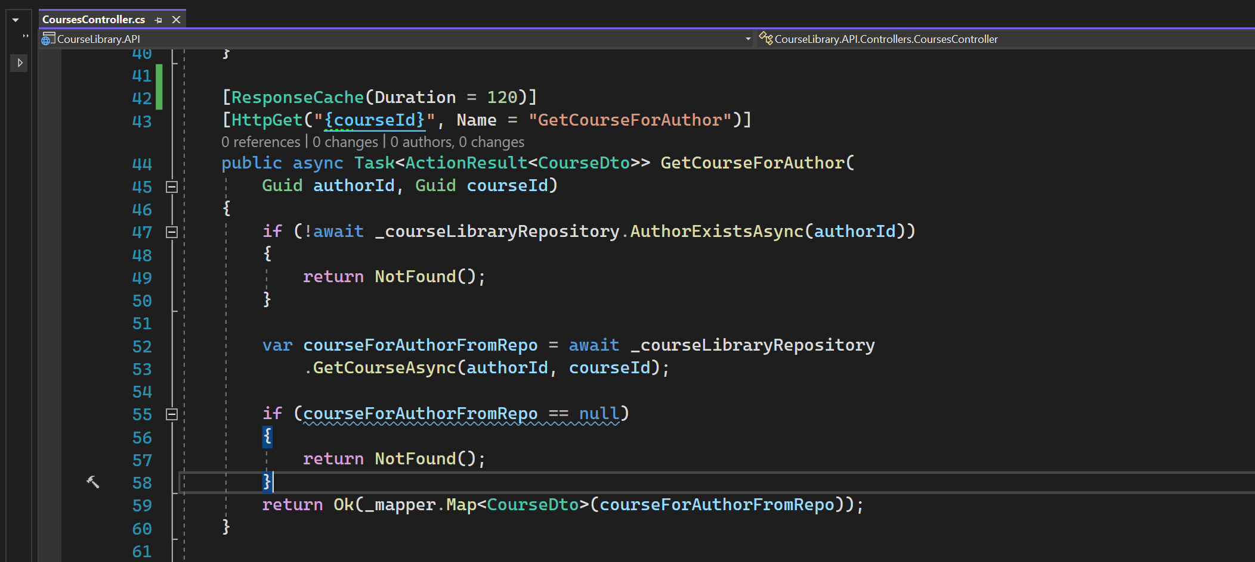
Adding cache headers

Slide 4
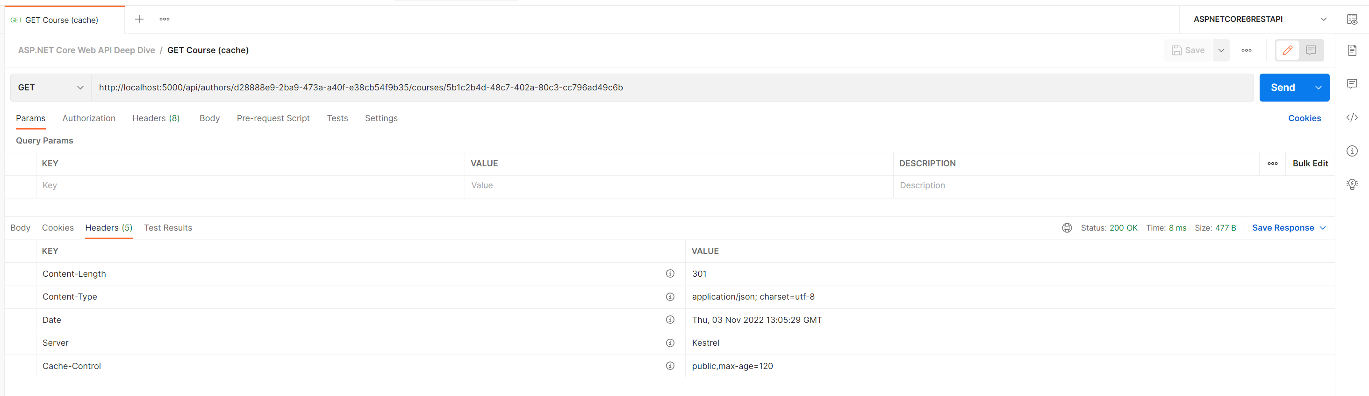
Cache-control
public means shared cache.
It can be used by public and private

Slide 5
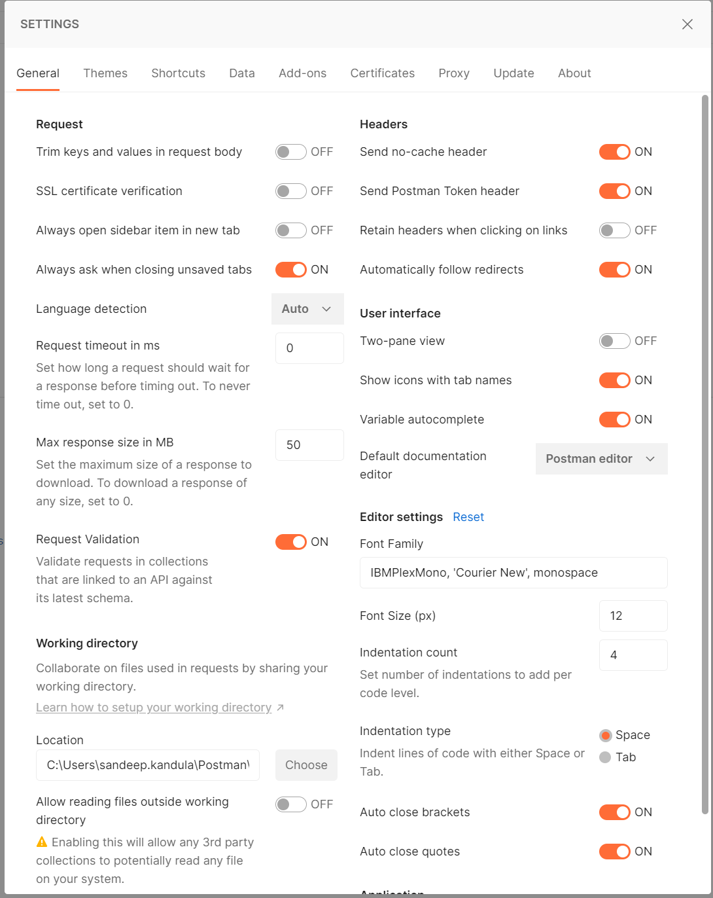
DEFAULT POST MAN SETTINGS

Slide 6
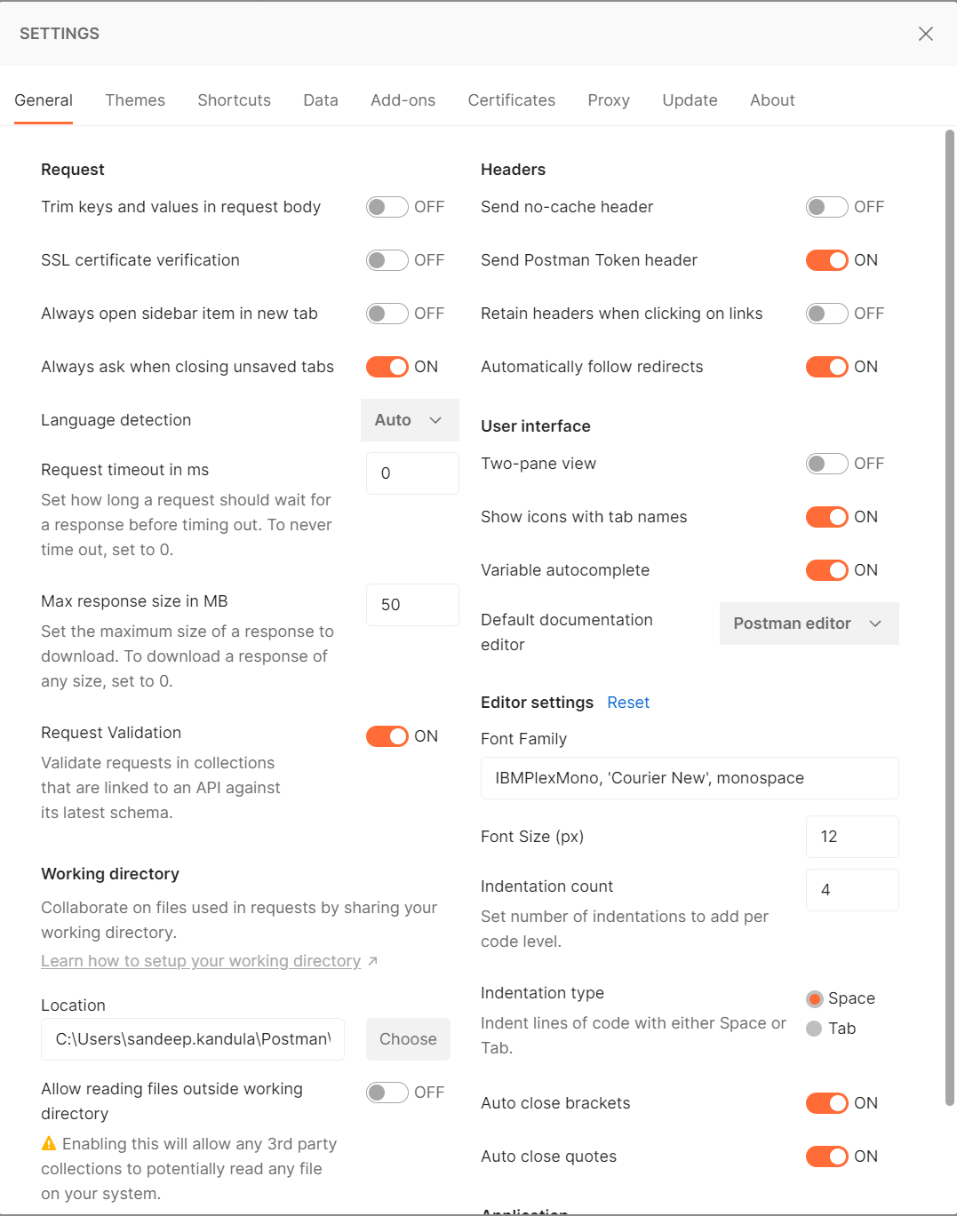
Send no cache header to off

Slide 7
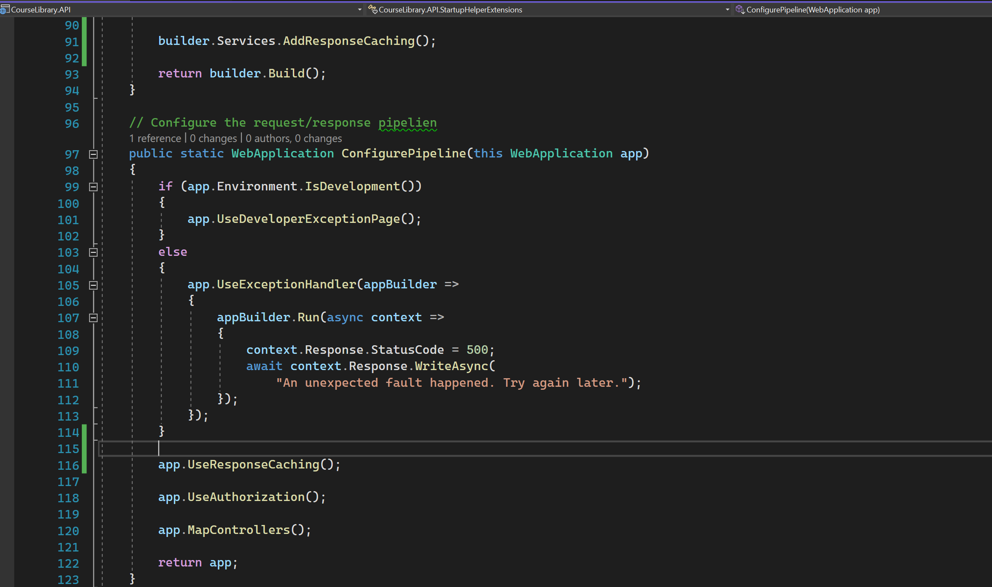
For cache to work, need to use cache store

Slide 8
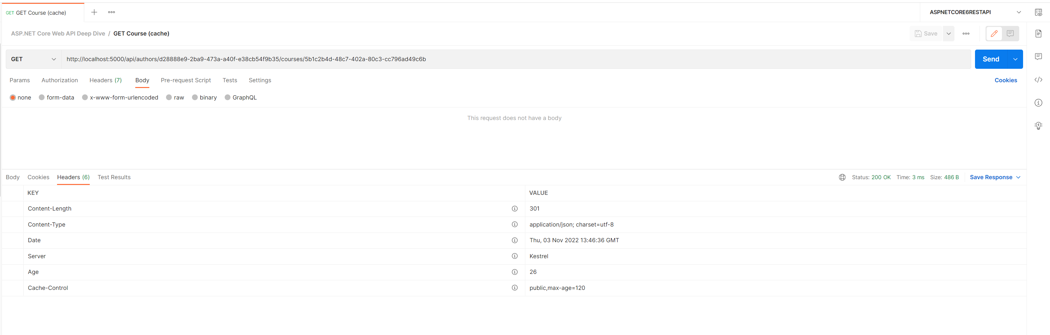
OBSERVE AGE
Will hit the backend after age expires.

Slide 9
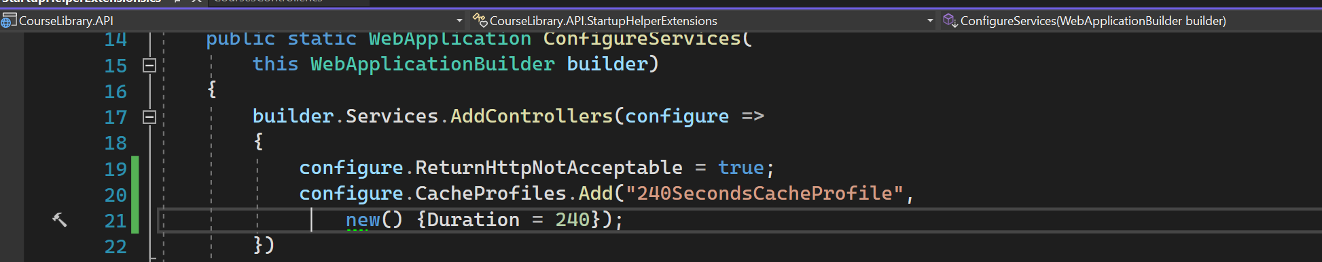
Cache profile - 1

Slide 10
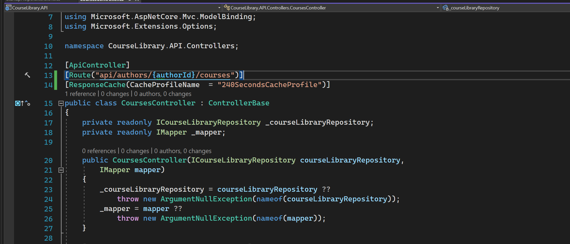
Cache profile - 2

Slide 11
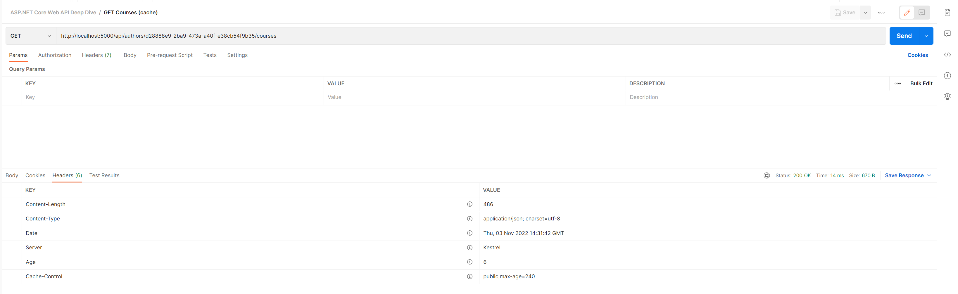
Cache profile - 3

Slide 12
Marvin caching (Full support for rest api)

Slide 13
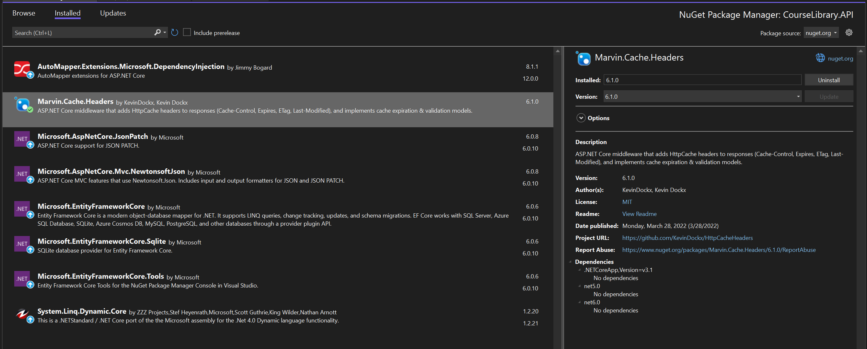
Add NUGET PACKAGE

Slide 14
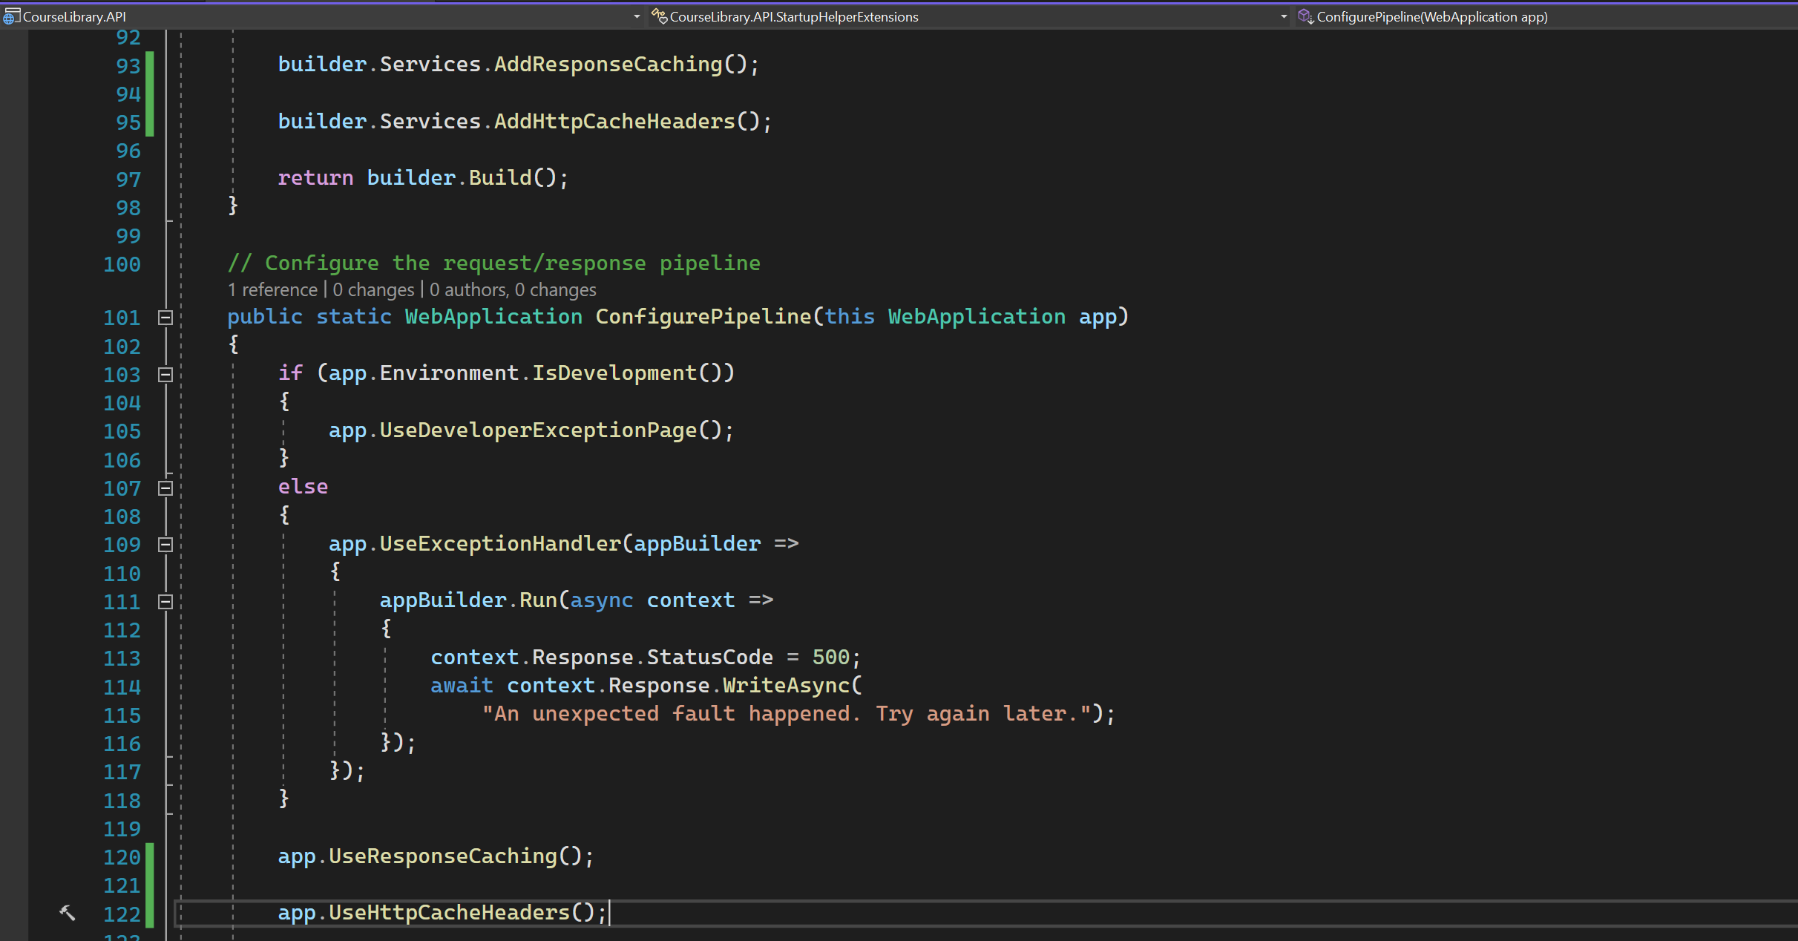
CACHE HEADERS

Slide 15
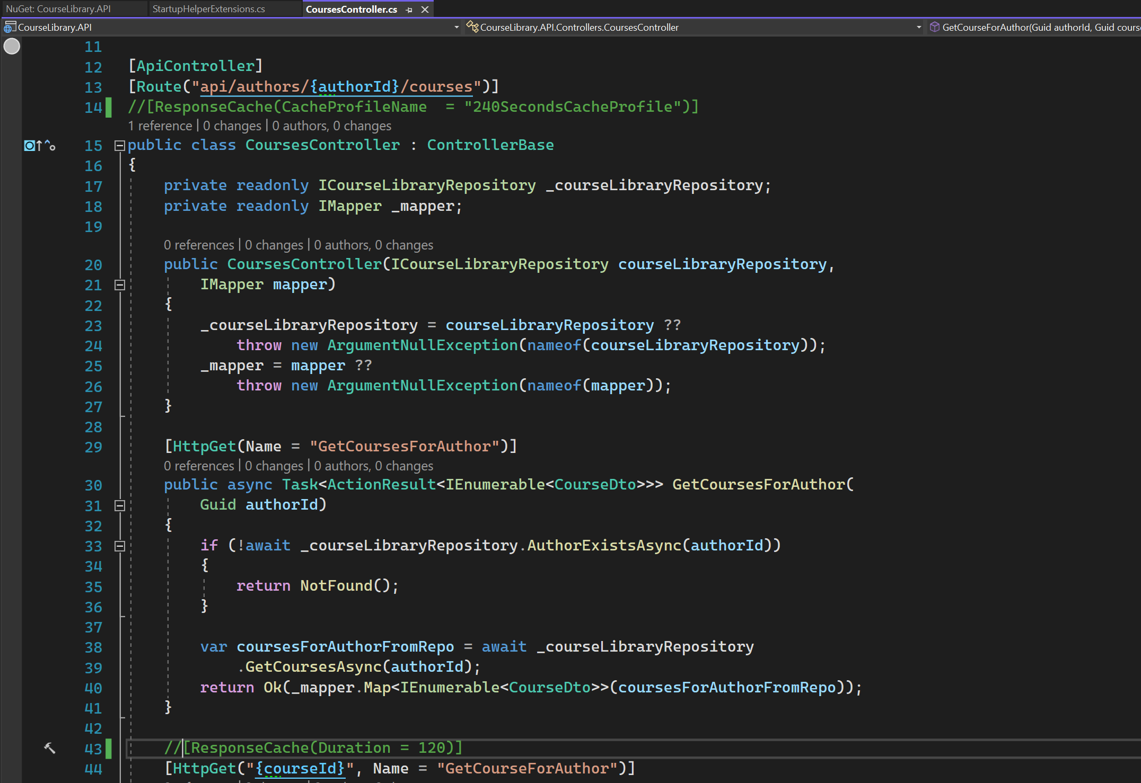
Comment down the response caches (Attributes)

Slide 16
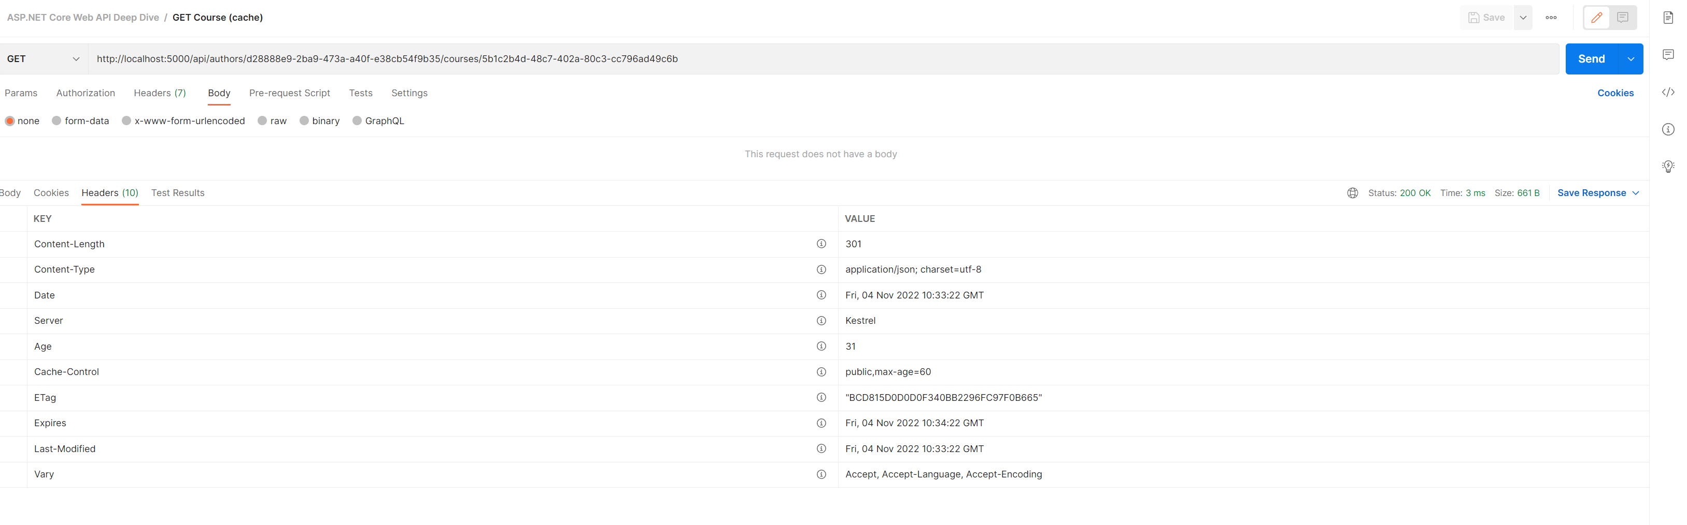
ETAG headers

Slide 17
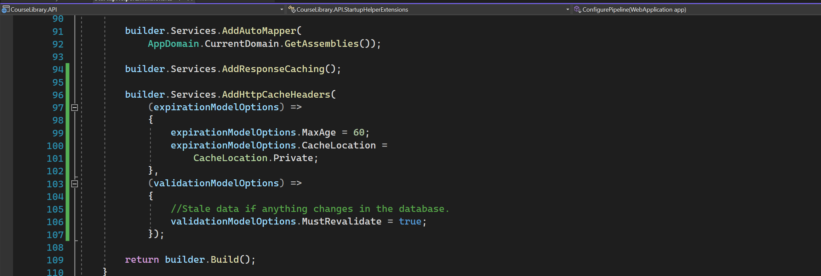
Global cache header configuration - 1

Slide 18
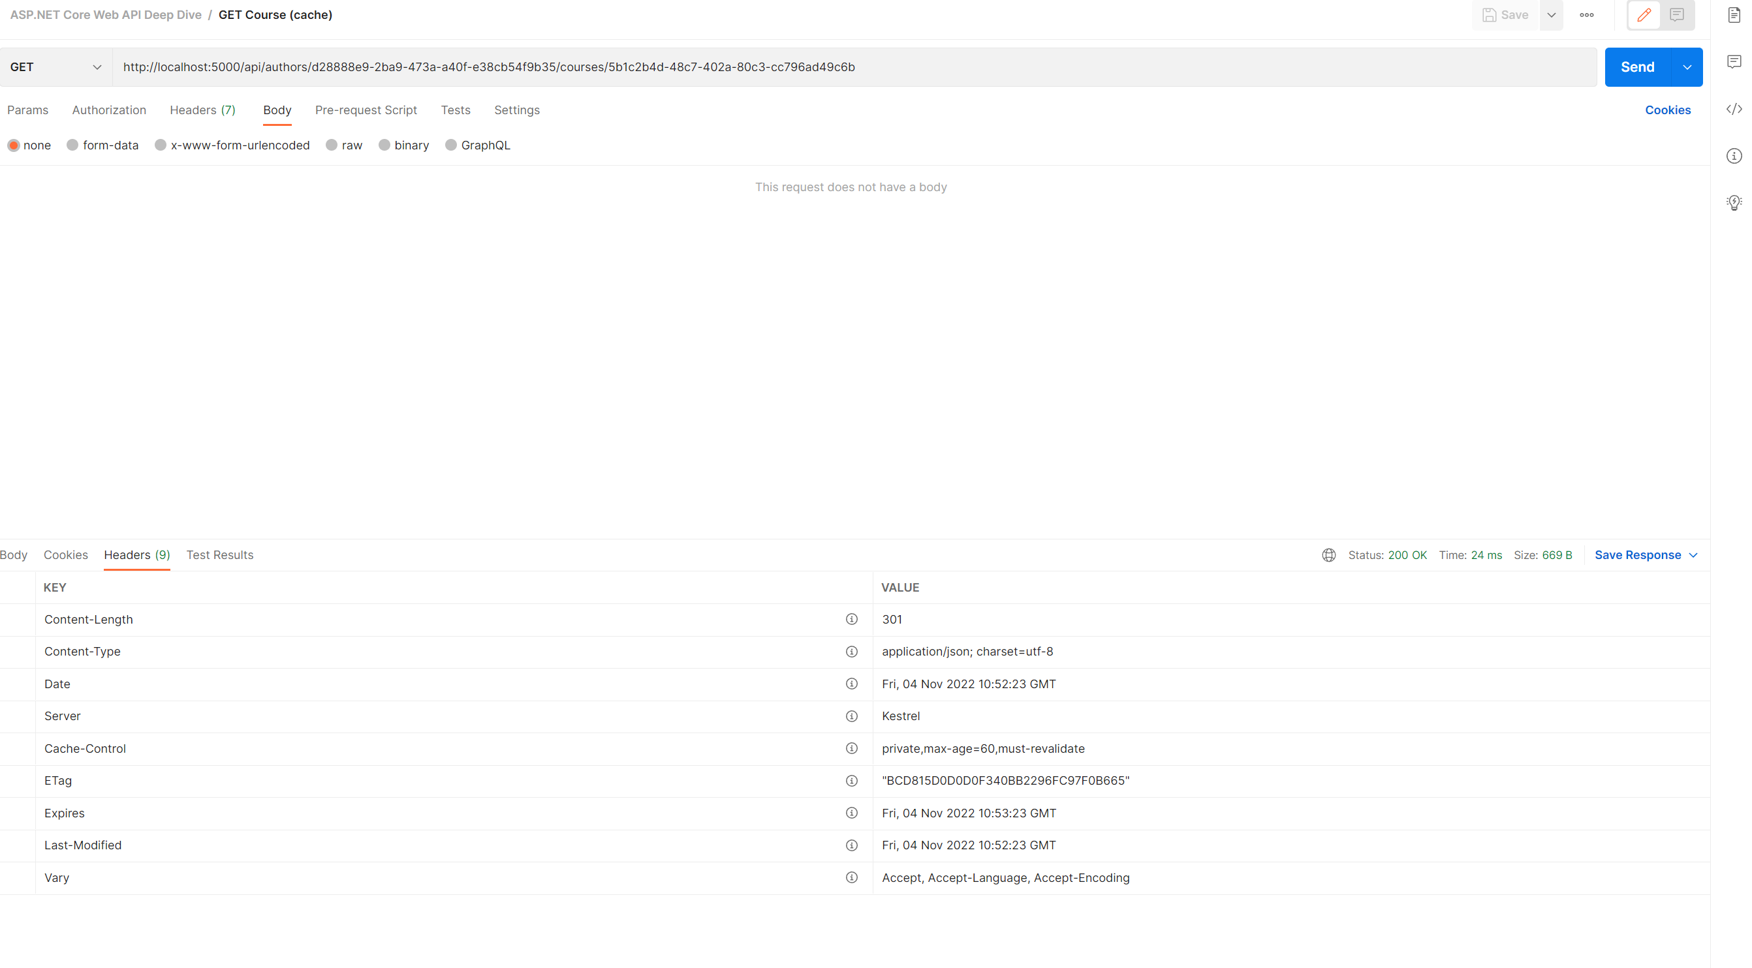
Global cache header configuration - 2
Must Revalidate has to be applied

Slide 19
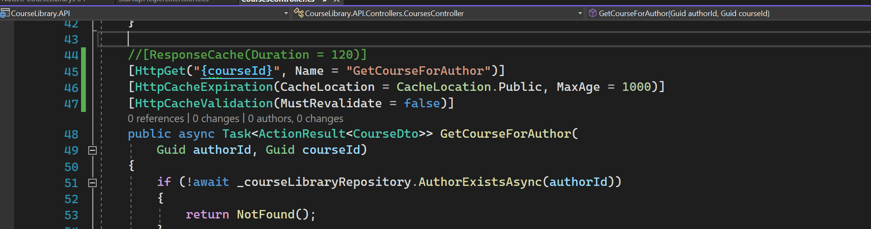
Resource level cache header configuration - 1

Slide 20
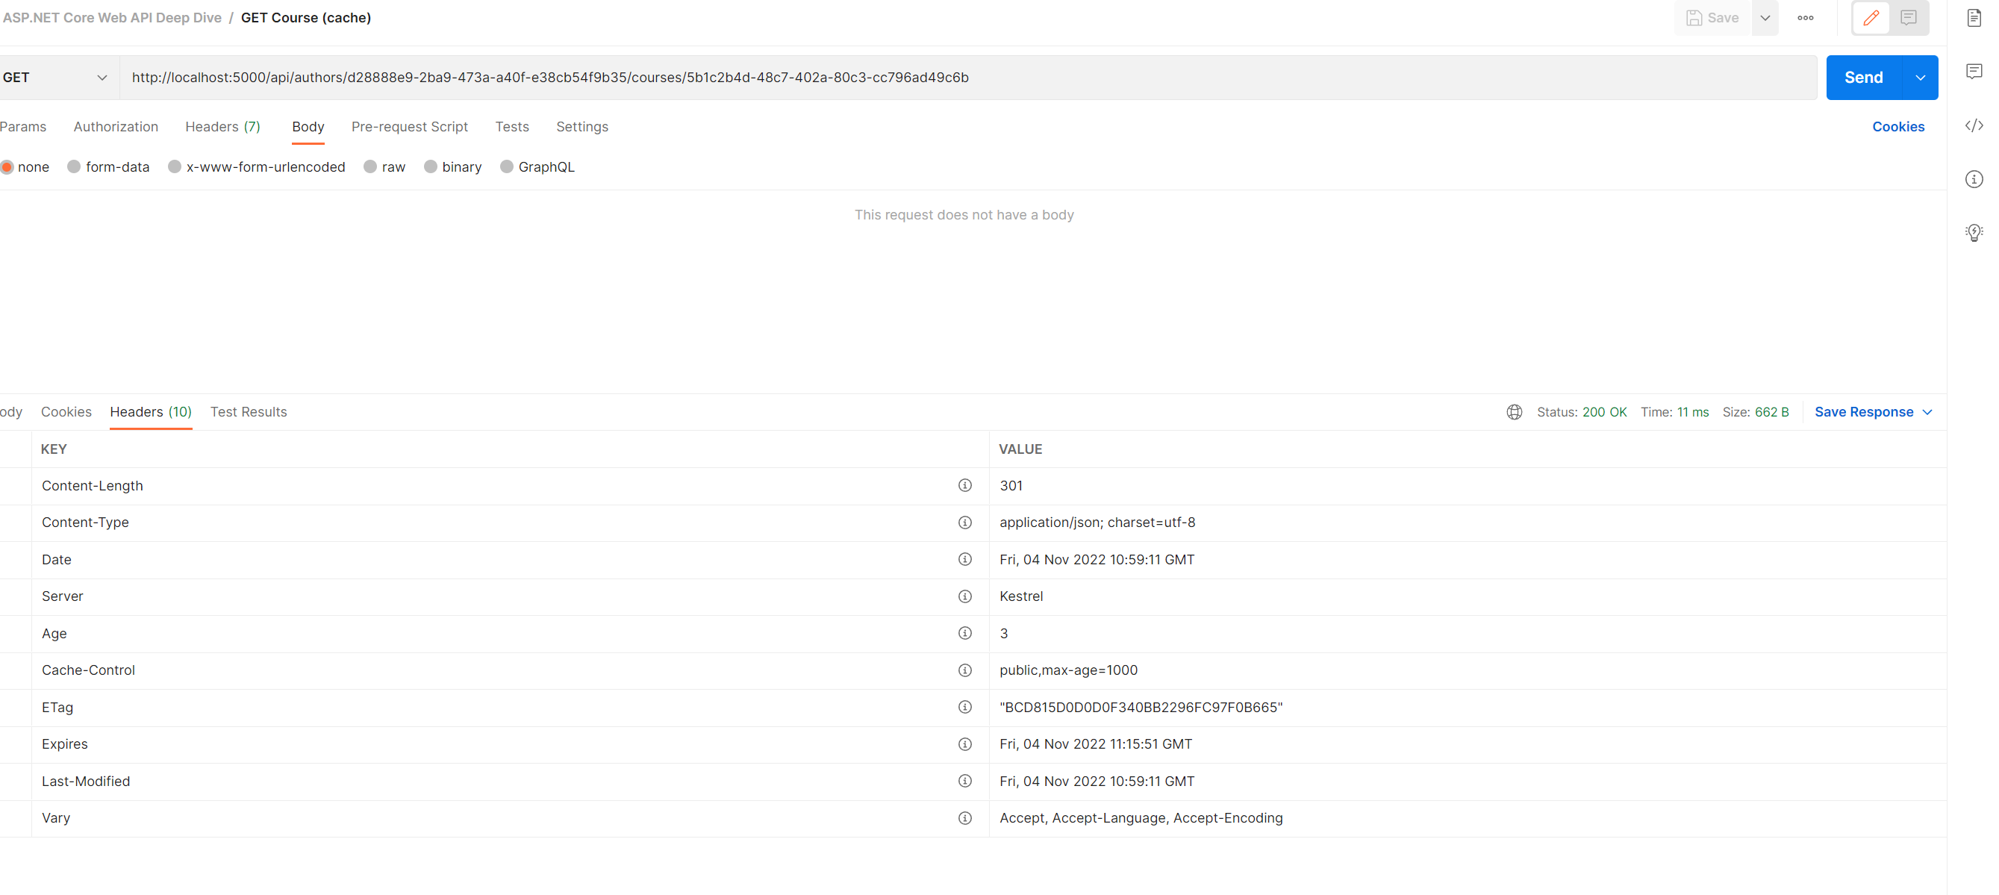
Resource level cache header configuration - 2

Slide 21
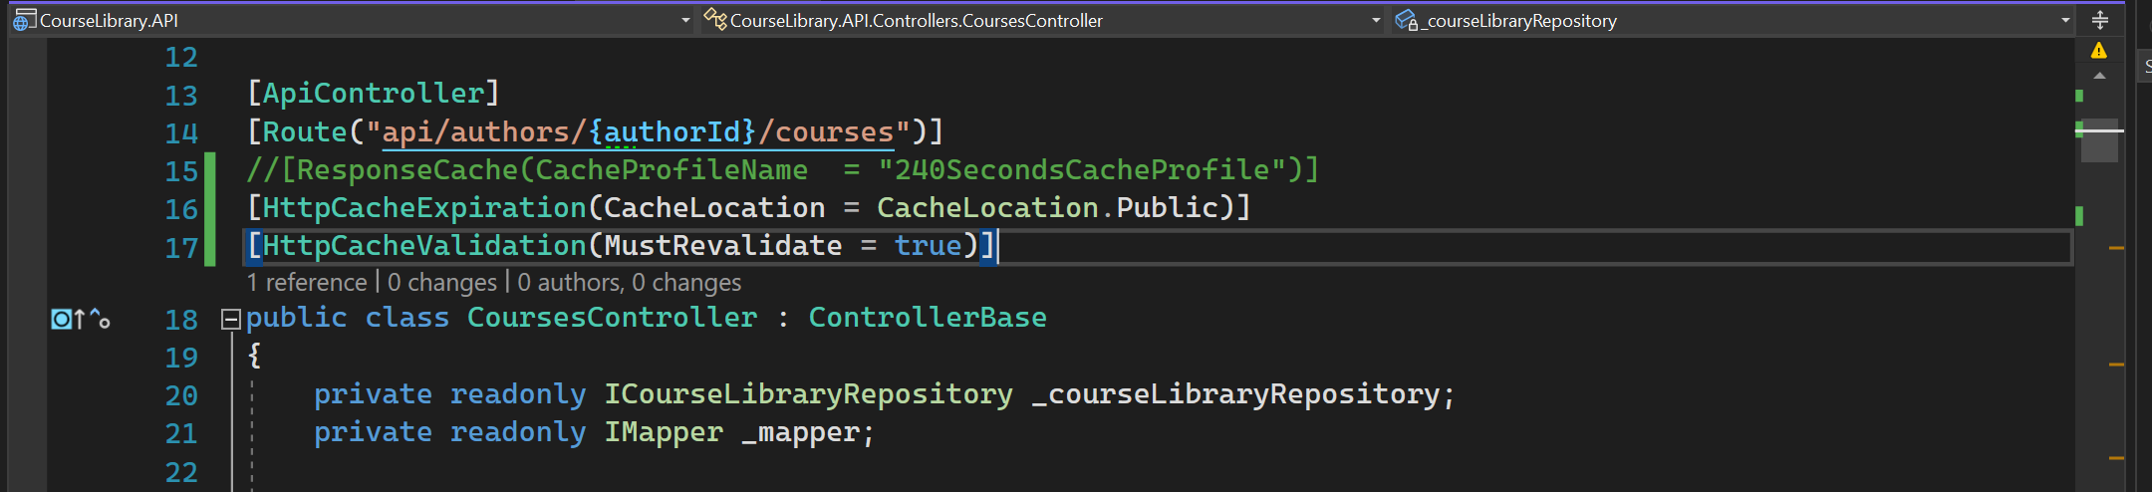
Resource level cache header configuration - 3

Slide 22
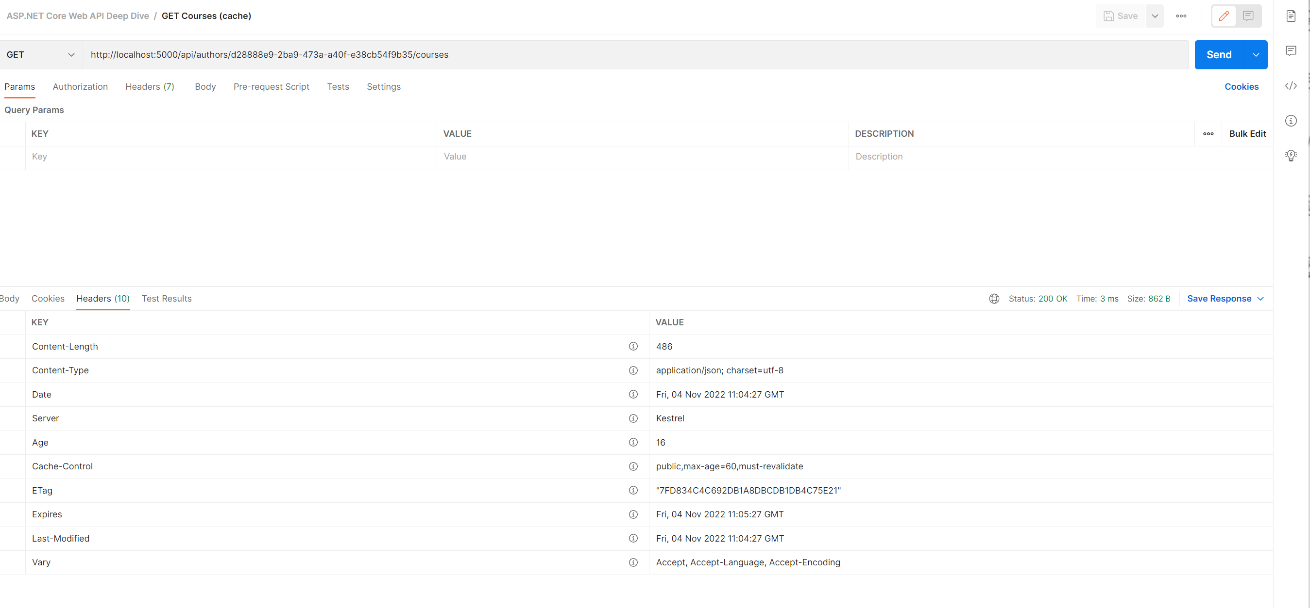
Resource level cache header configuration - 4

Slide 23
CACHE
Works across XML and JSON independently.
JSON cache and XML cache.

Slide 24
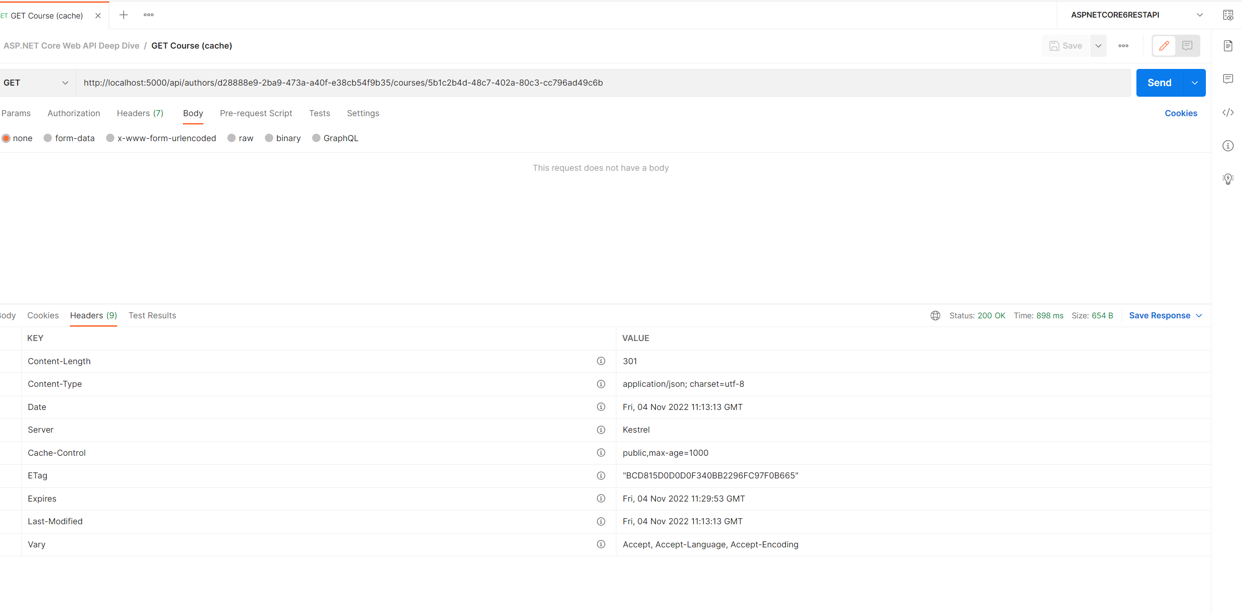
VALIDATE MODEL - 1

Slide 25
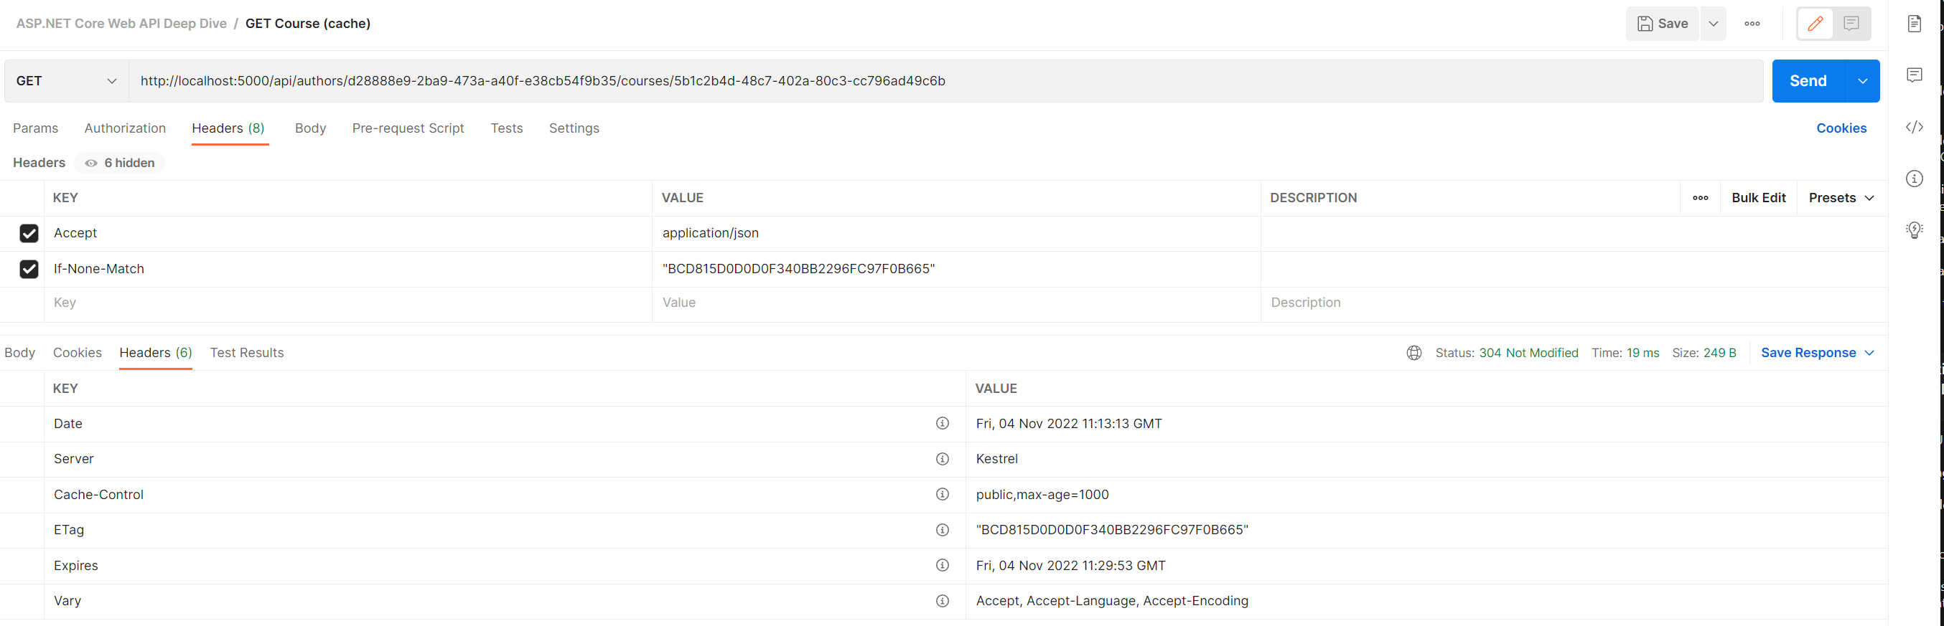
VALIDATE MODEL - 2

Slide 26
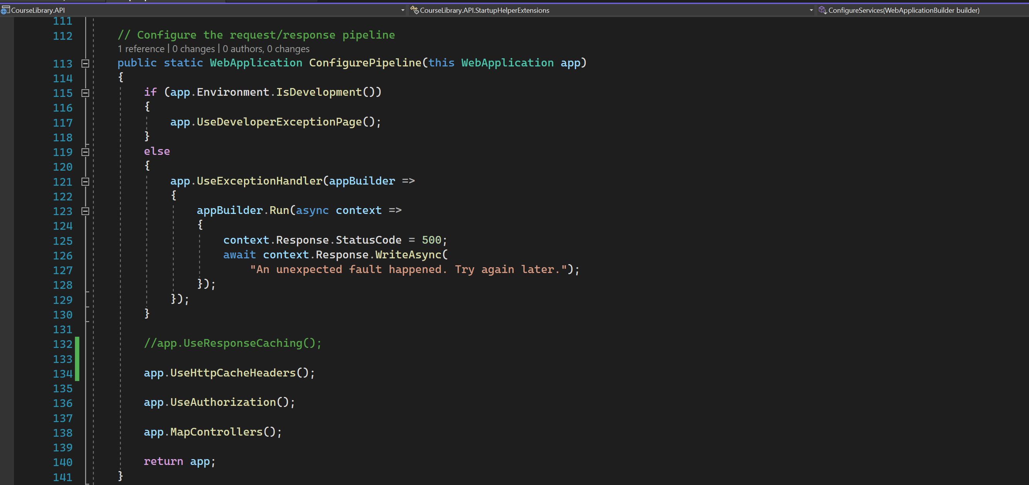
Use RESPONSE CACHING – NOT GOOD FOR VALIDATION

Slide 27
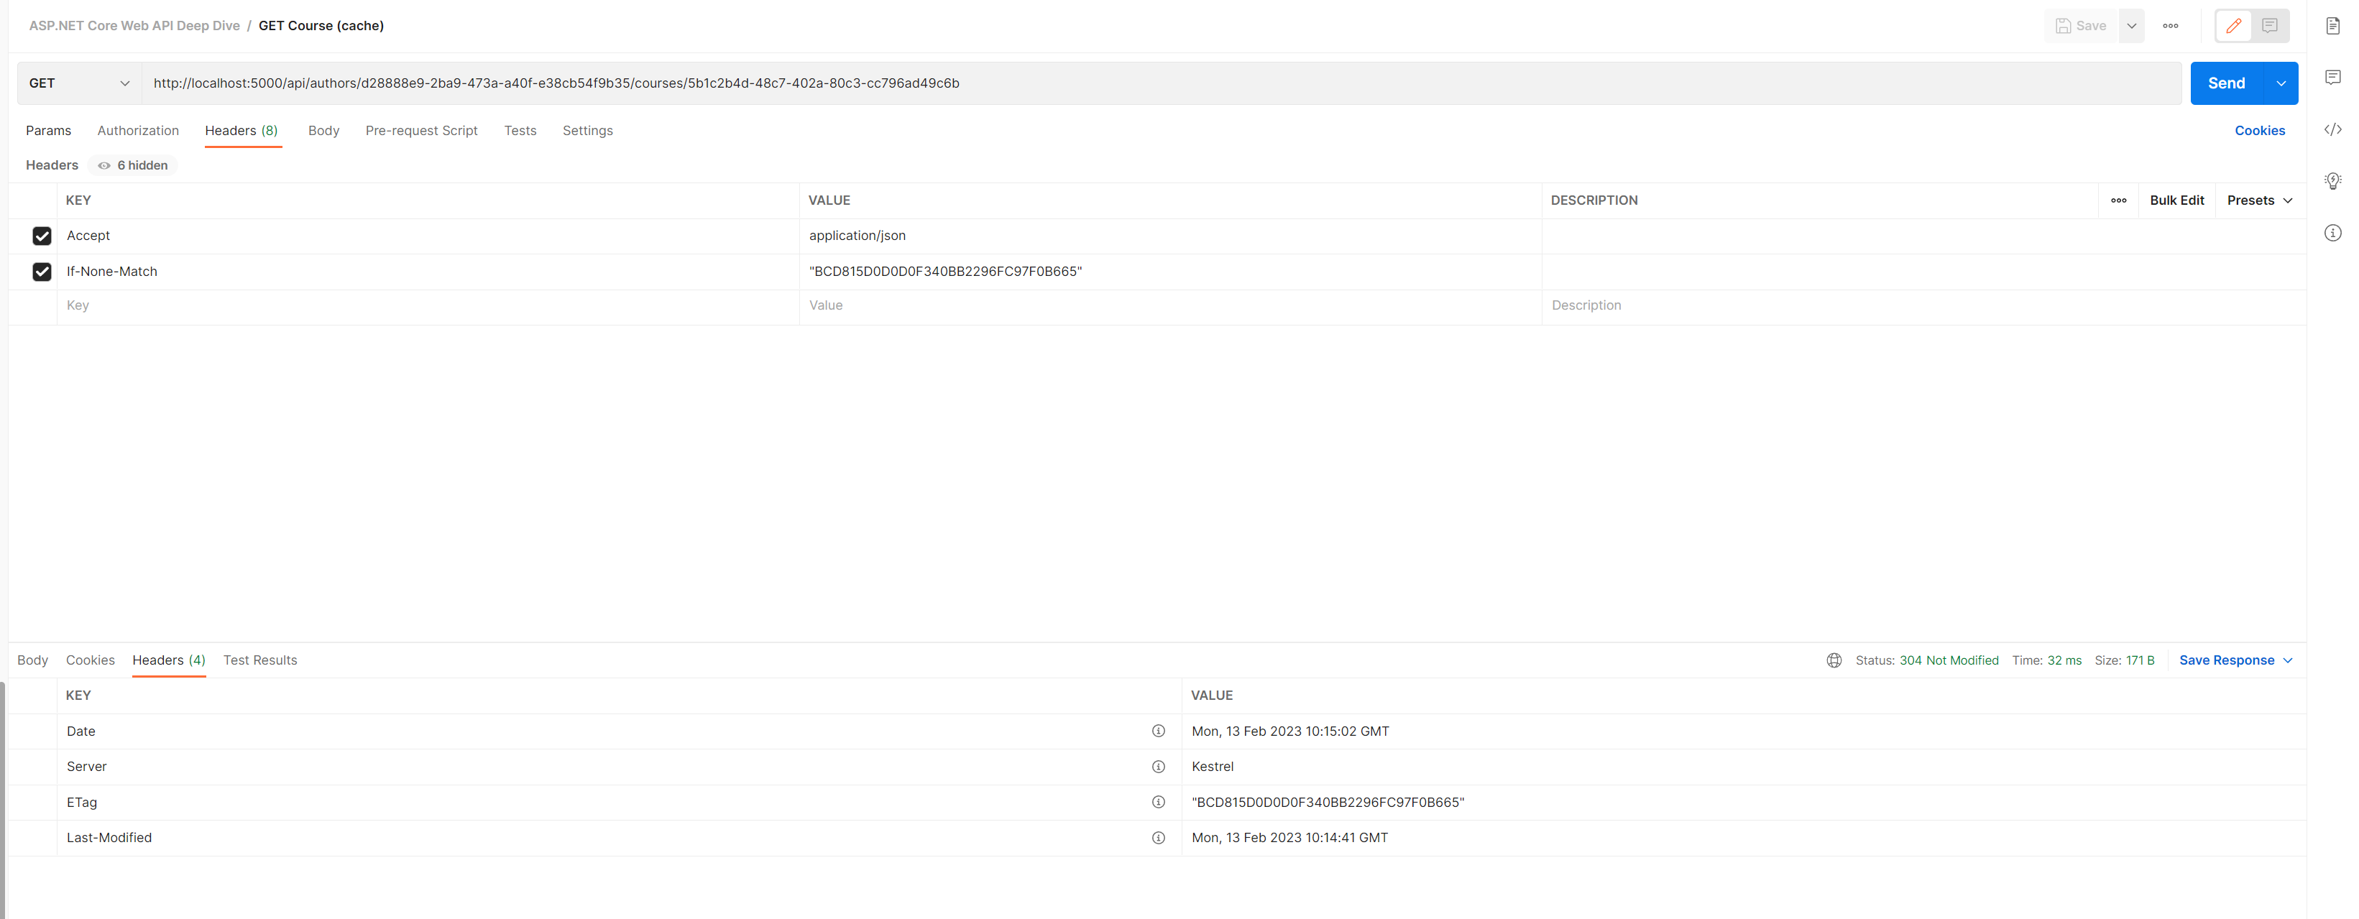
Use RESPONSE CACHING – NOT GOOD FOR VALIDATION

Slide 28
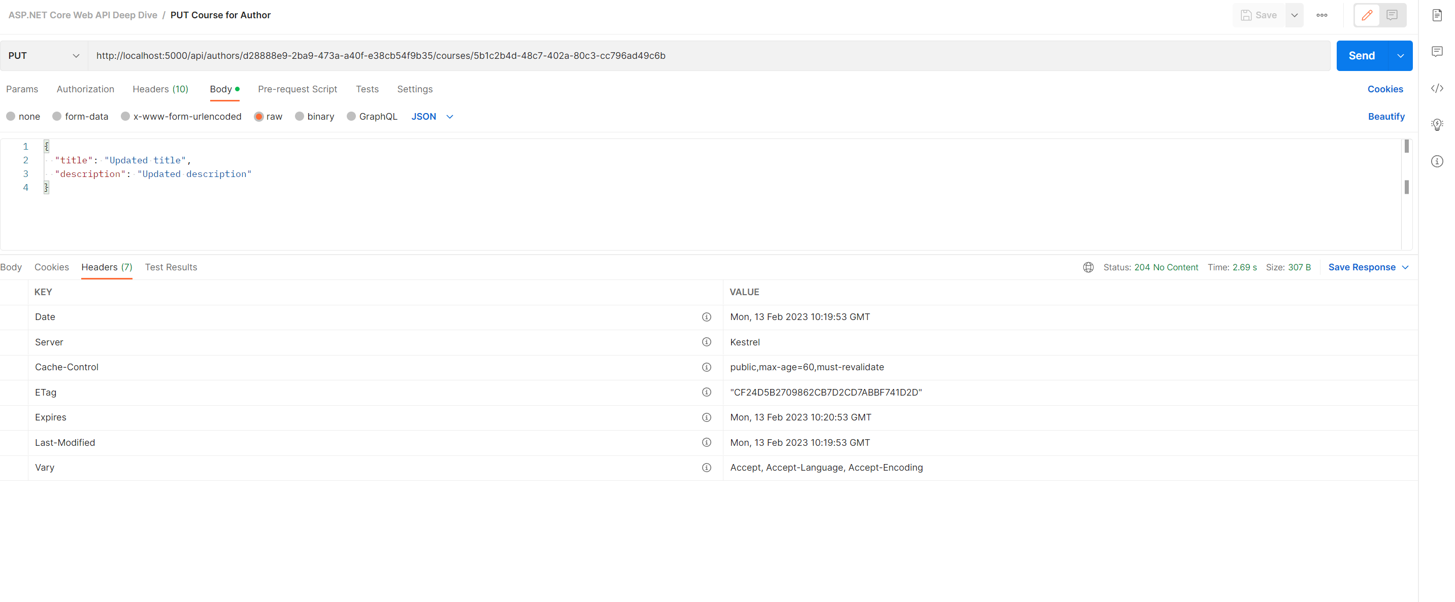
Use RESPONSE CACHING – NOT GOOD FOR VALIDATION

Slide 29
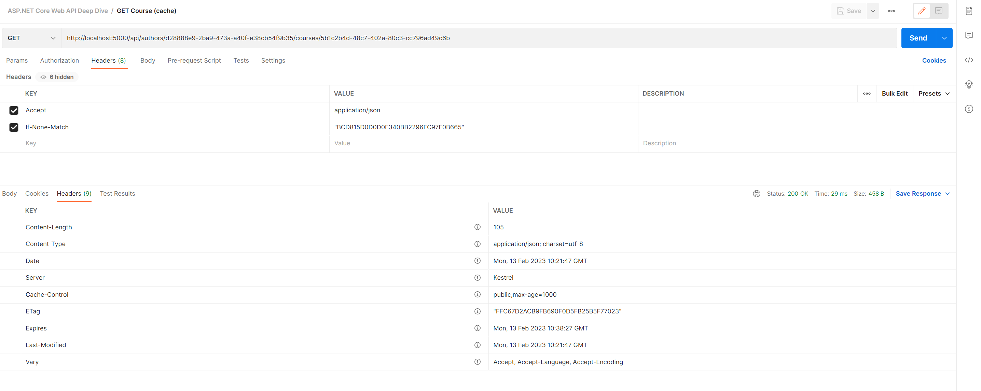
Use RESPONSE CACHING – NOT GOOD FOR VALIDATION

Slide 30
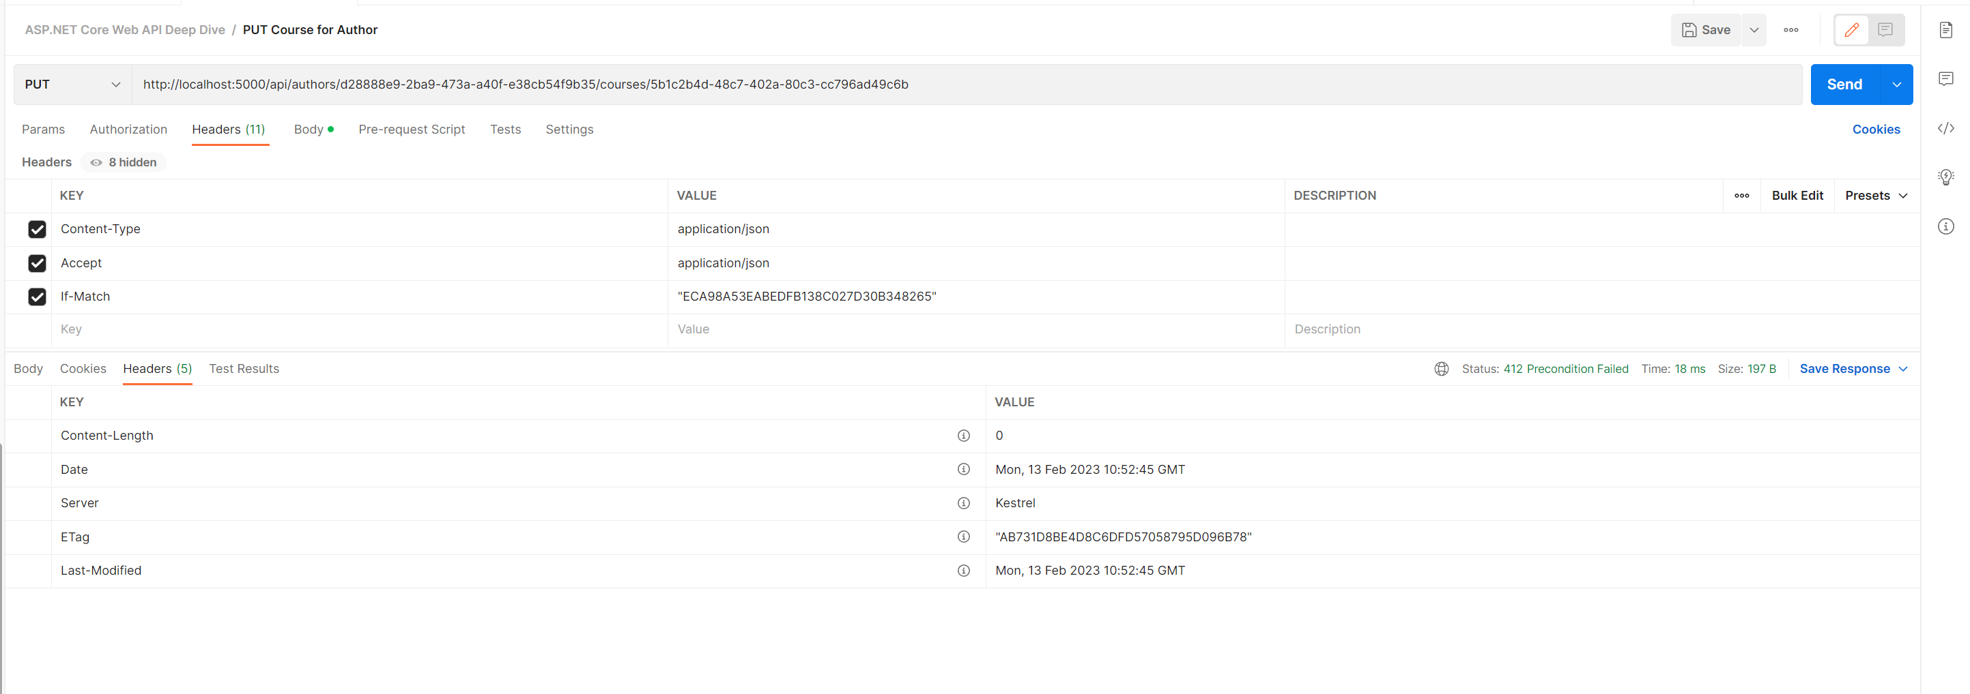
CONCURRENCY

Slide 31
validation

Slide 32
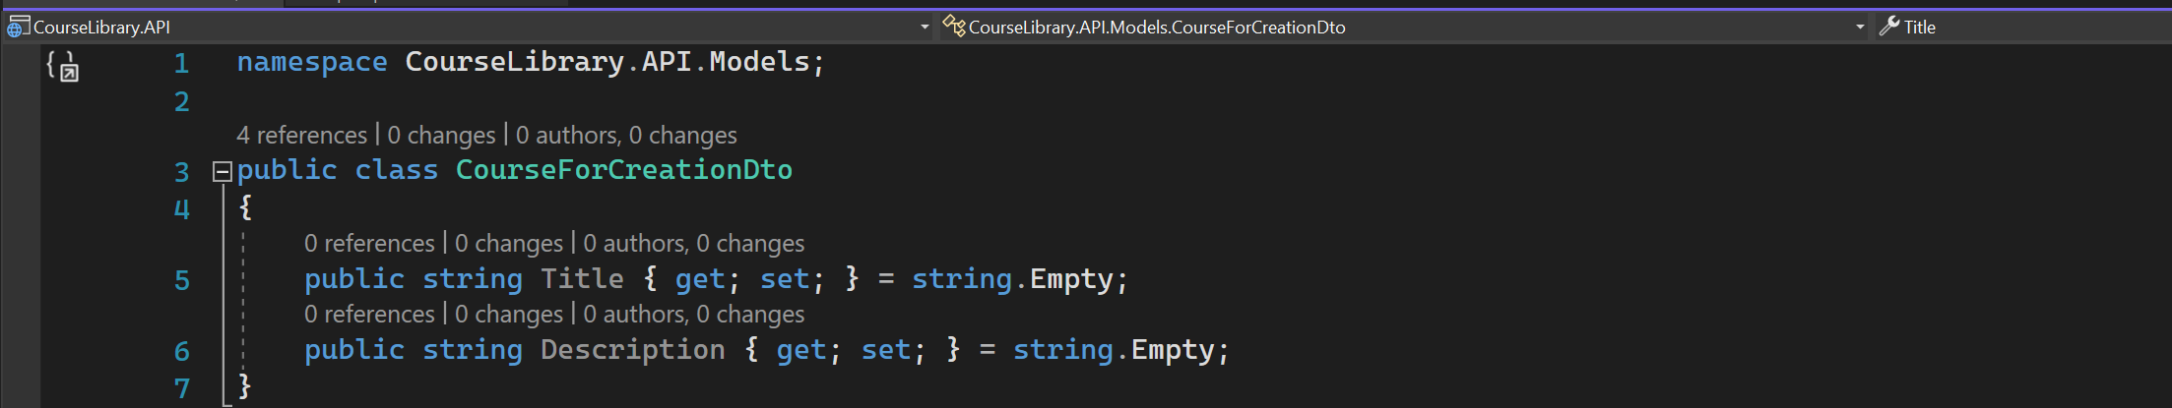
COureseforcreationdto

Slide 33
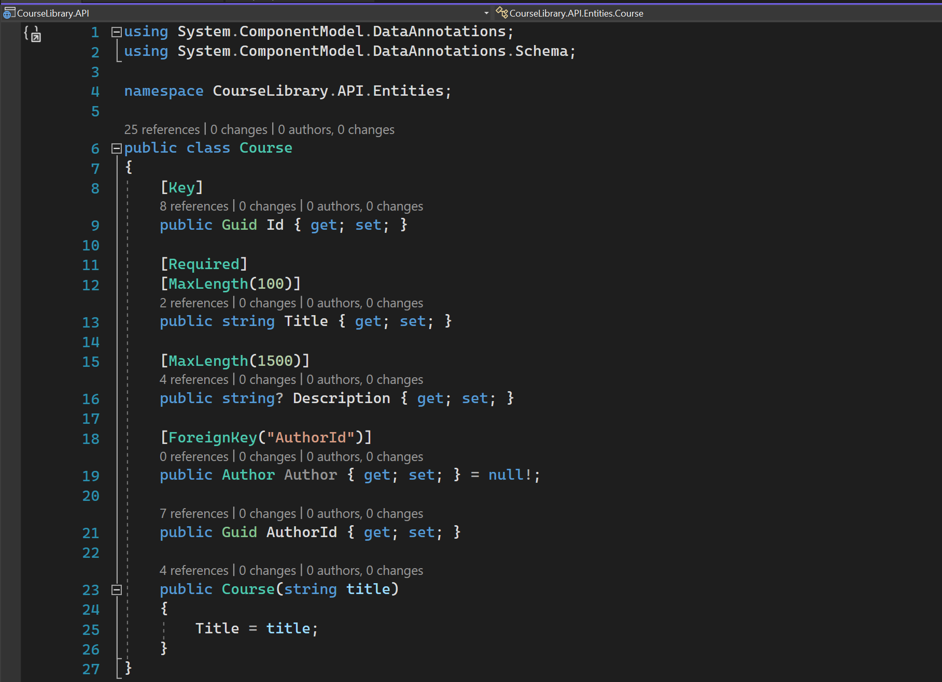
COURSE ENTITY

Slide 34
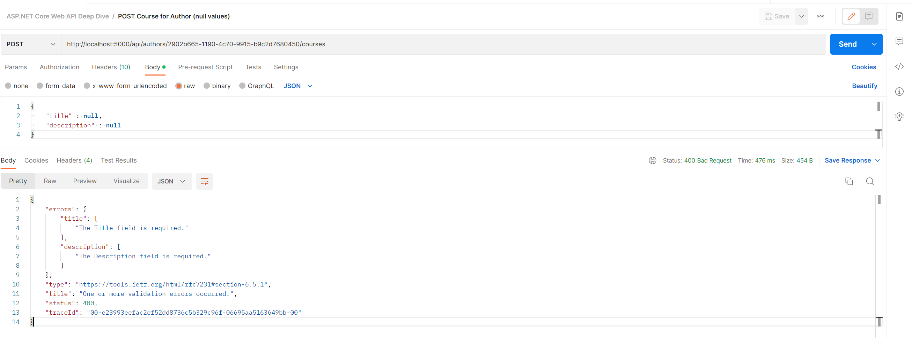
POST COURSE – Null values

Slide 35
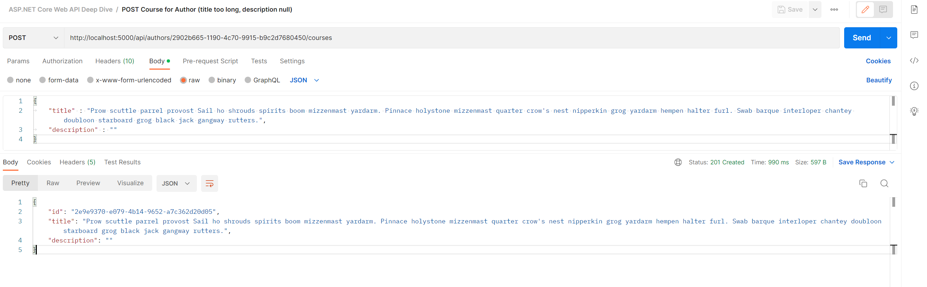
POST Course for Author (title too long, description null)
Created resource.

Slide 36
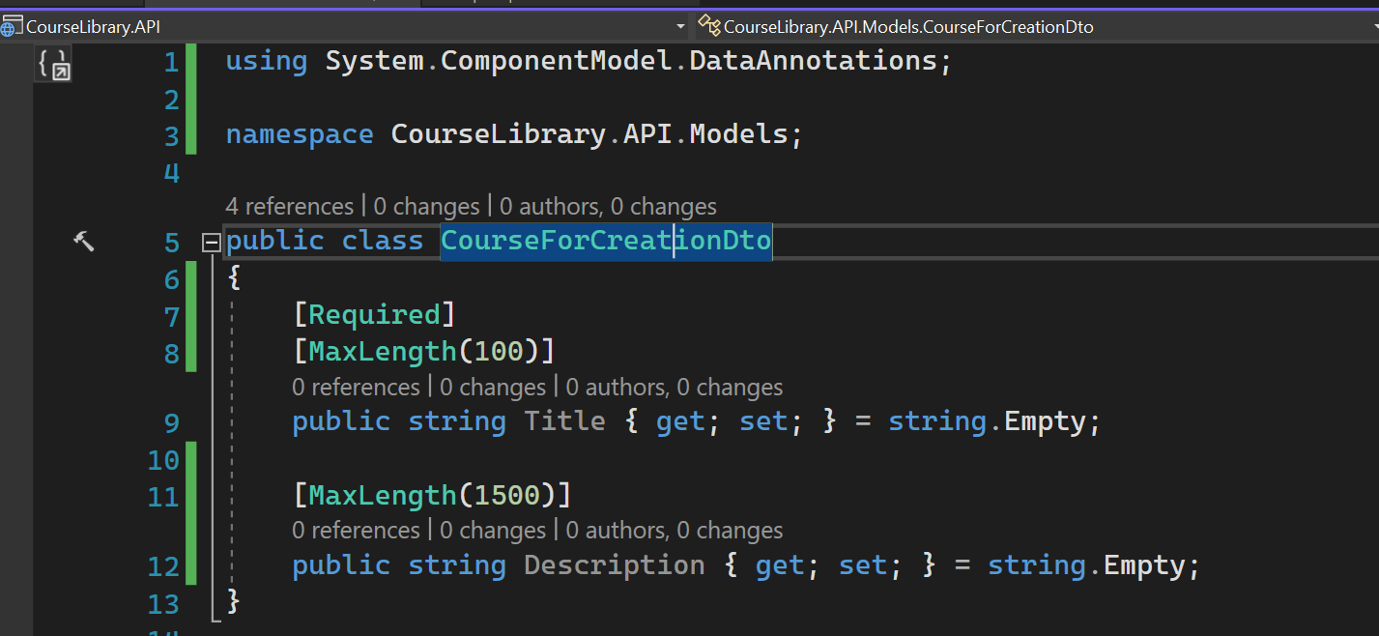
Data annotation attributes

Slide 37
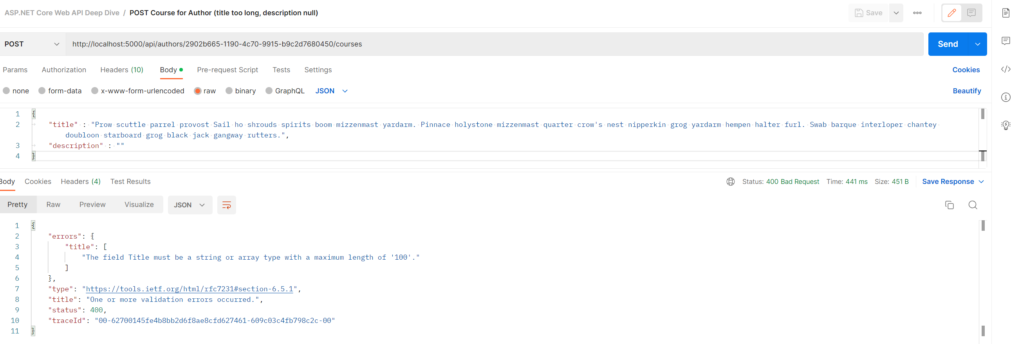
Validation based on data annotation

Slide 38
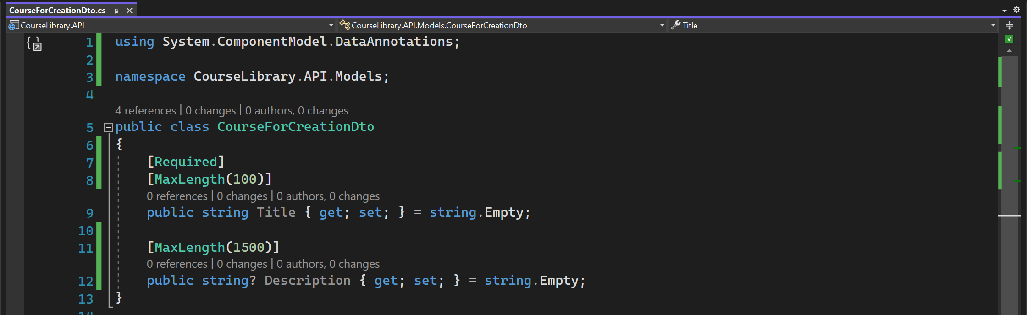
Nullable for description - 1

Slide 39
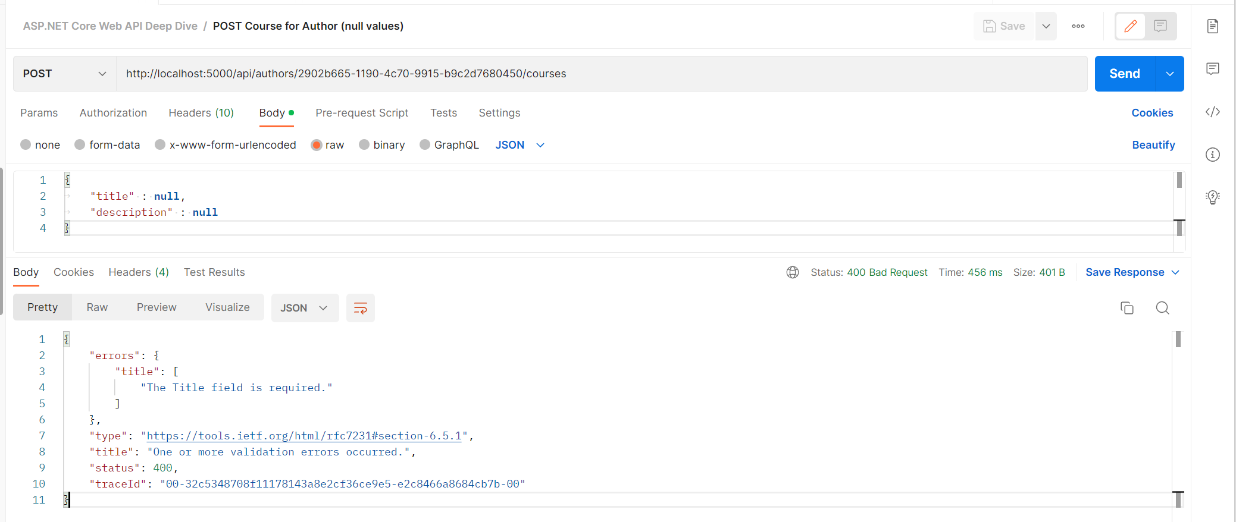
Nullable for description - 2

Slide 40
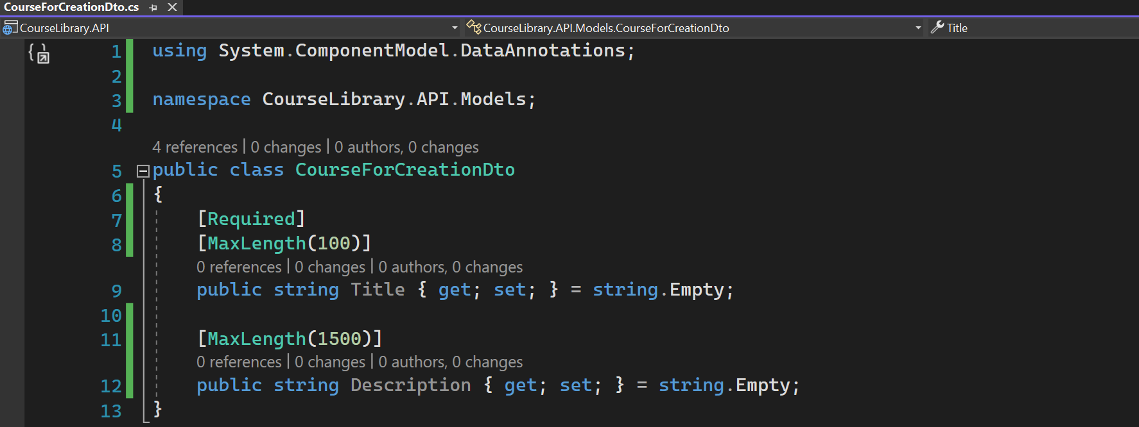
Remove nullable

Slide 41
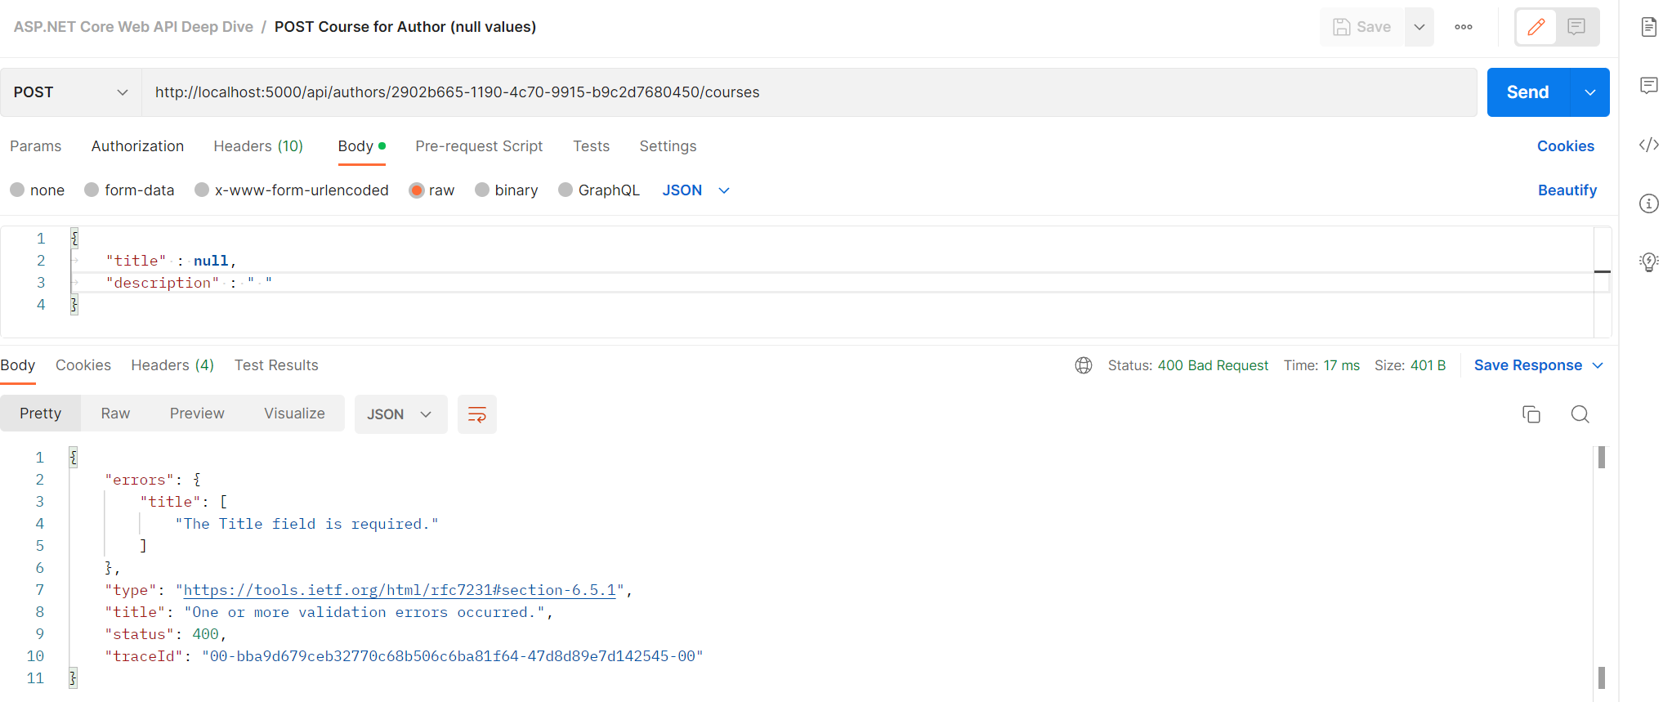
EMPTY DESCRIPTION

Slide 42
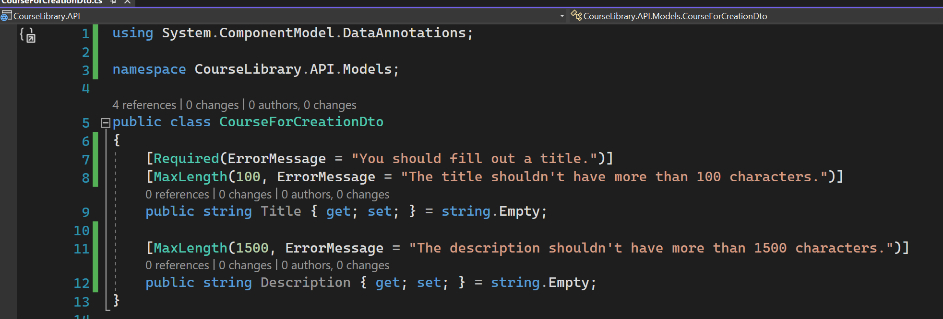
Customize error message - 1

Slide 43
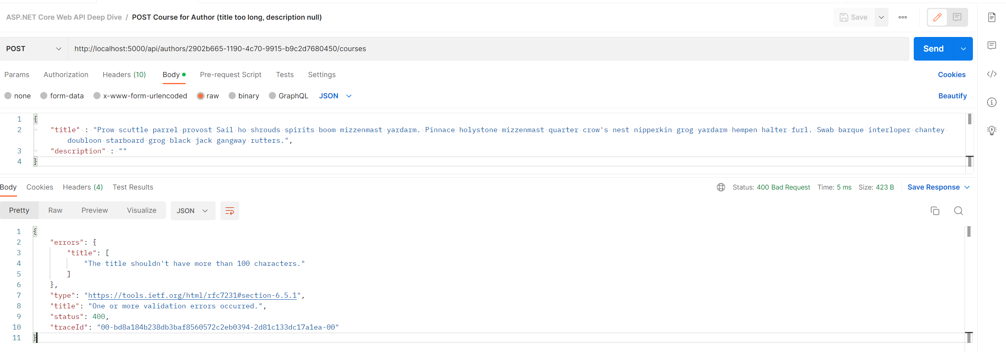
Customize error message - 2

Slide 44
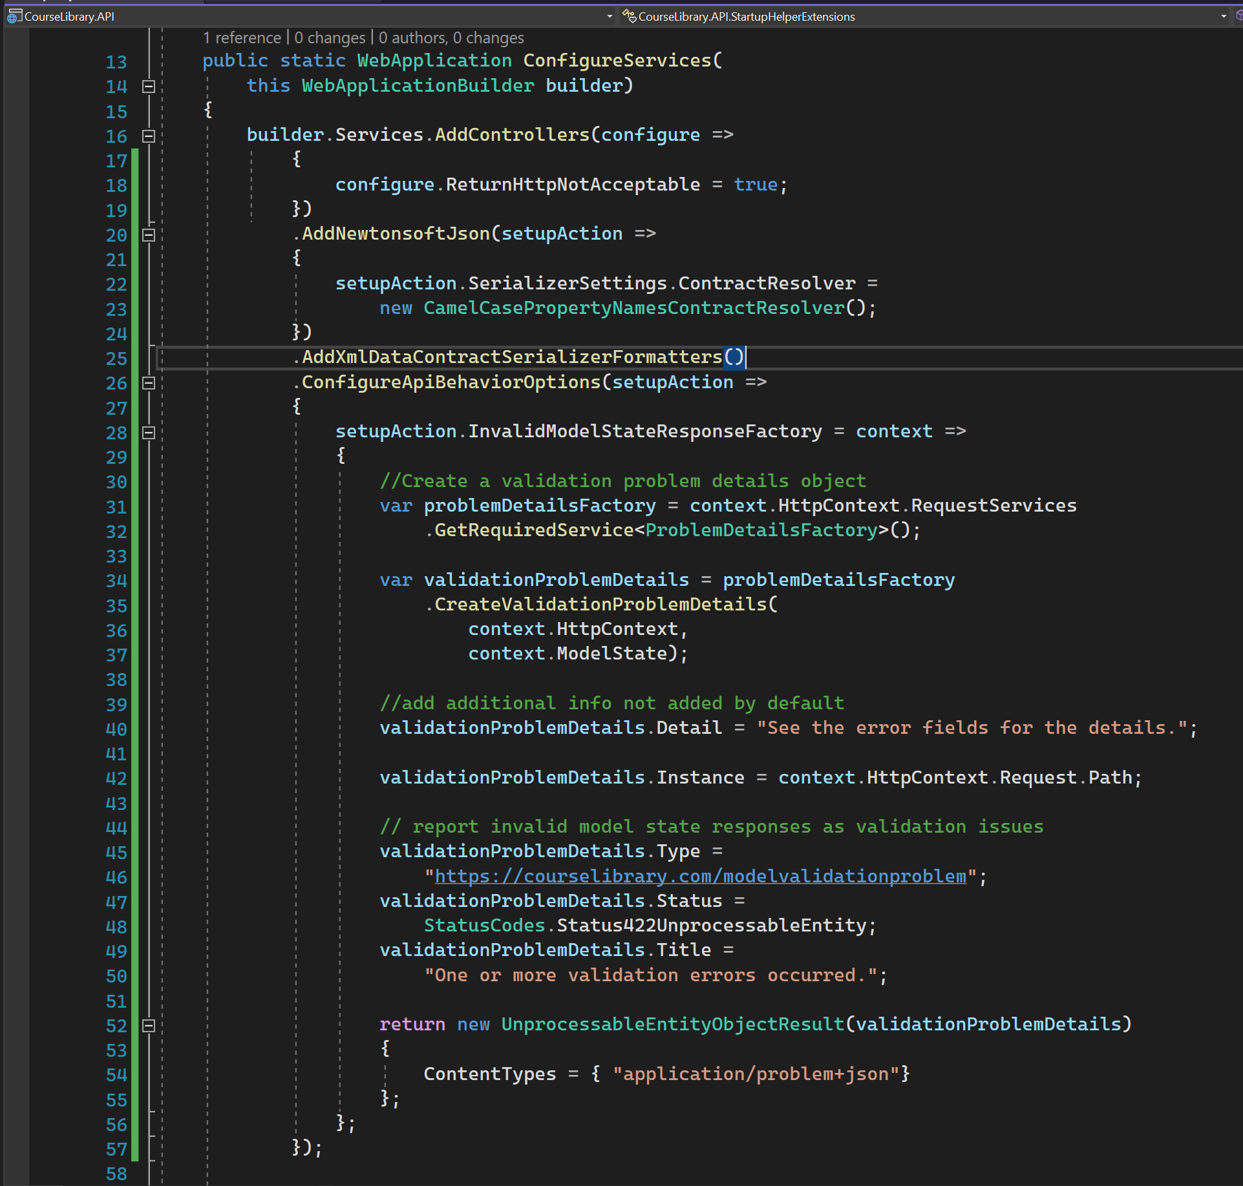
Set it to 422 - 1

Slide 45
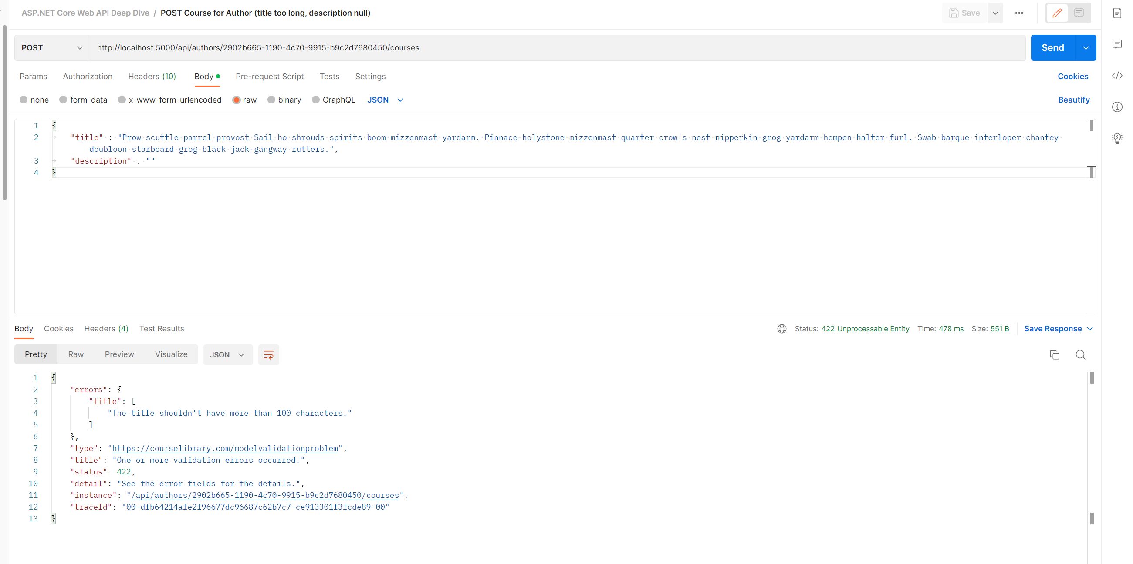
Set it to 422 - 2

Slide 46
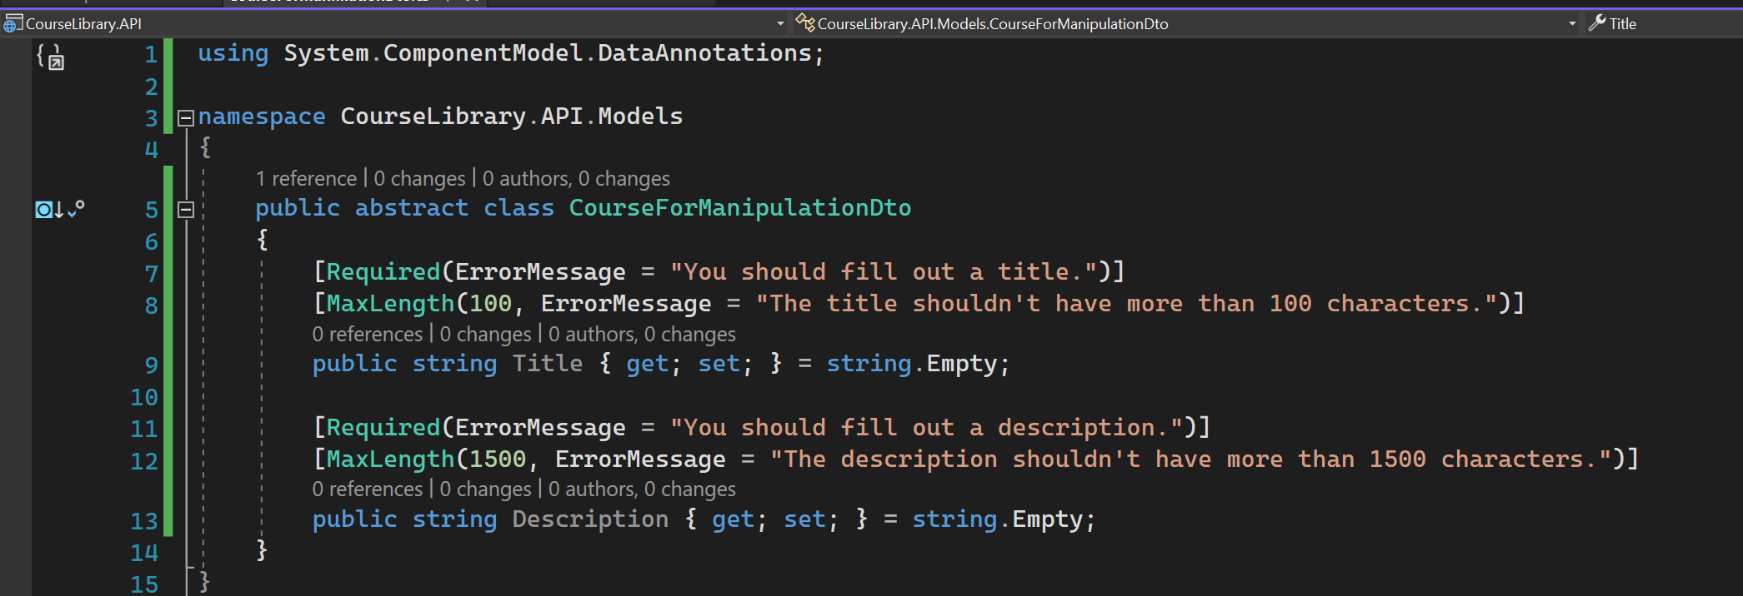
Validation for put - 1

